Slide 1
Arcade Strategies to maximize profit
(ASTMP)

Slide 2
BMPS SCALE
* BMPS = rate of (20SB per year) (K0.15 per second)
(/) BMPS = rate of (100SB per year) (K0.8 per second) (K70 per day)
1 BMPS = rate of (400SB per year) (K3 per second) (₦3k per day)
2 BMPS = rate of (2KSB per year) (K15 per second) (₦14k per day)
3 BMPS = rate of (4KSB per year) (K32 per second) (₦28k per day)
4 BMPS = rate of (10KSB per year) (K80 per second) (₦70k per day)
5 BMPS = rate of (12KSB per year) (K95 per second) (₦82k per day)
6 BMPS = rate of (1MSB per year) (₦1.58 per second) (₦137k per day)
7 BMPS = rate of (1.5MSB per year) (₦2.37 per second) (₦205k per day)
8 BMPS = rate of (2MSB per year) (₦3.17 per second) (₦274k per day)
9 BMPS = rate of (3MSB per year) (₦4.75 per second) (₦410k per day)
10 BMPS = rate of (4MSM per year) (₦6.34 per second ) (₦548k per day)

Slide 3
Use of referrals: Knowing that the entrance fee weekly is ₦499, referrals would be timed to bring in a particular amount of new customers but payed half of the sum to be collected from the customers entrance fees only if the referral meets the deadline
Use of human psychological tricks to keep customers occupied: e.g., mirrors, toys, fid getters, fish 0mini aquariums, stray candy on the floor random tablets bottom of popcorn pack writes ‘finished already ?’etc.
The No time illusion: the arcade has been designed with the intentions of no windows or clocks to keep the customers unaware of the time outside while being busy, furthermore we would also make the ceiling to
Companies family plans exploitation: take each member of a family plan to be a stranger while slightly reducing the price to lower than what the companies are offering

Slide 4
Creating minor inconveniences and selling solutions as extremely cheap subscriptions
Creating members only mini lotteries and keeping 30% of the money input
Making customers participate in streaks, and after each month of consecutive entry's they win something
Creating payed participation for leadership board and the person on top wins prize
Sales from merchandize (profit of N15000)

Slide 5
Unlimited data plans

Slide 6
There are 2 types of Dome arcade Data bundles
Inside the arcade Data bundle (Arcade online)
This is the data bundle present in the vicinity of the dome arcade
outside the arcade Data bundle (Arcade online bundles)
This is the data bundle present outside the vicinity of the dome arcade
You must be subscribed to the In-arcade subscription to enjoy the benefits of the out of arcade Data bundles

Slide 7
Out of the arcade (Arcarde online bundles)
Must be subscribed to in the arcade unlimited data bundle
Pay N549 for 4GB in 6 days
Pay N1799 for 12GB in 9 days
Pay N14990 for 90Gb in 33 days
buy merch to get 1GB free for each month of purchase only (12Gb)

Slide 8
Capacity
Wi-Fi passwords change daily (scan QR to login)
Company pays 500k for 5TB yearly
500 people pay N5999 monthly = N35 million made yearly
Then 100k (1TB) for games and streaming

Slide 9
Dome arcade Merchandize
Dome arcade makes top wears with a different color annually Pop corn and drinks for the next 5 days only
Perks that comes with purchasing the merch
Free movie daily for the next 5 days (hoodie and jacket only)
Extra 8Gb of Data on the N1999 for 12GB weekly bundle (hoodie and jacket only)
Allows the advantage of having seats in competitions
Person who Wears the merch for the most days consecutively wins prizes
Upgrade your merch by swopping in with us to get about 30% off the next generation of merchandize
only one perk remains after the first swopping, 10GB of extra data yearly

Slide 10

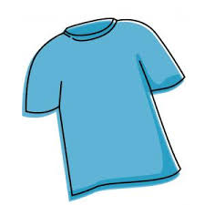
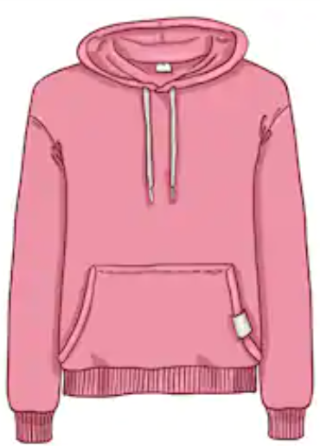
There are only 3 types of Merch
Jackets
Shirts
Hoodies

Slide 11
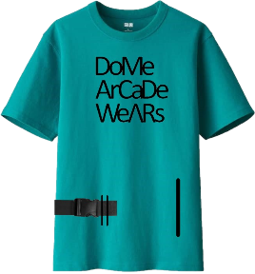
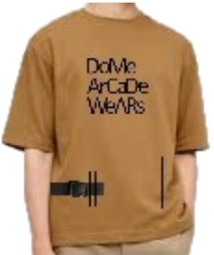

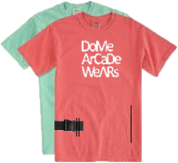
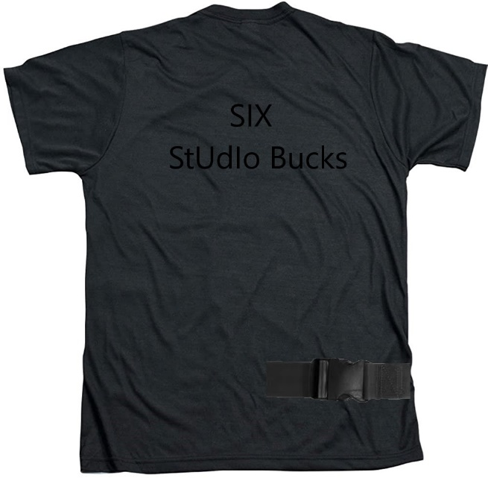
Dome arcade Merchandize Shirt
only 10,000 made annually
New color way Releases on February 28
Contains: plastic belt, waterproof interior, zip able pouch, Glow in the dark “arcade”
6 Studio bucks or (N14,990) only
5 Studio bucks for Kids (10 years max)

Slide 12
Merch jacket (N74,990) only 5,000 made
Or (1 Studio bucks 10 musthyds weekly)
New color Releases on June 28 annually
Contains: two plastic belt, waterproof interior, zip able pouch, Glow in the dark “Dome arcade wears”
30 Studio bucks
Or 10 Studio bucks a month

Slide 13
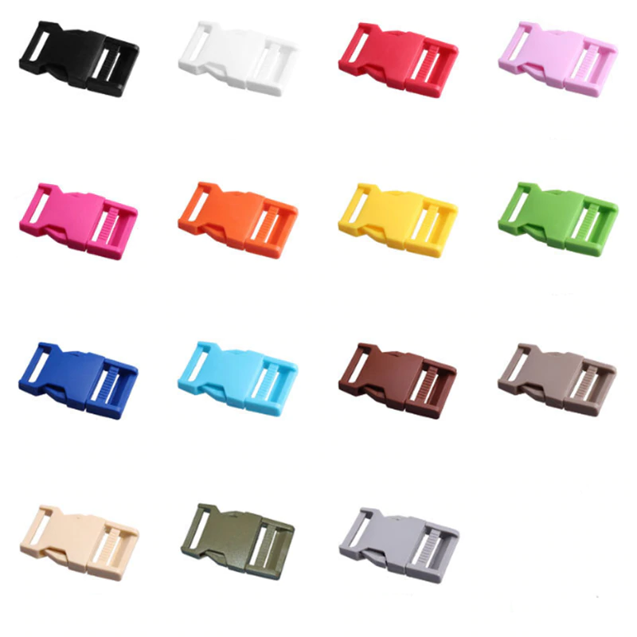
Change belt buckle for N2500
Per piece

Slide 14
Why you should become a member?
Membership to the dome arcade covers a lot of your daily needs while also saving you a lot of money when compared to just being a regular customer

Slide 15
General plans for referrals
There are an unlimited amount of referrals needed hence reducing unemployment
Gives out valid recommendations with no advertisements costs
Helping teenagers by providing certificate of participation for only (₦5000 monthly)
Register for auto registration for 5% off next payment

Slide 16
Types of referrals

Slide 17
funds referrals
₦1000 per 3 new people 10 days ₦10 registration fee
referrals assessment task free follow and reshare us on 3 social medias with a sum of at least 10 views + likes
Referrals codes Goes in the format F13john

Slide 18
side referrals
₦7,000 per 20 new people 30 days ₦50 registration fee
referrals assessment task ₦9 bring 2 new customers in a week
Follow and reshare us on 3 social medias with a sum of at least 35 views + likes
Referrals codes Goes in the format S59john

Slide 19
advanced referrals
₦20,000 per 60 new people 30 days ₦500 registration fee
referrals assessment task ₦99 bring 3 new customers in a week
Follow and reshare us on 3 social medias with a sum of at least 500 views + likes
Referrals codes Goes in the format A33john

Slide 20
Pro referrals
₦100,000 per 350 people per 30 days ₦5000 registration fee
referrals assessment task ₦499 bring 7 new customers in a week
Follow and reshare us on 3 social medias with a sum of at least 10,000 views + likes
Referrals codes Goes in the format P50john

Slide 21
Dawn referrals
₦1,000,000 per 4500 people per 60 days ₦50000 registration fee
referrals assessment task ₦999 bring 20 new customers in a week
Follow and reshare us on 5 social medias with a sum of at least 10,000 views + likes
*must upload posts wearing merch
Referrals codes Goes in the format D11john

Slide 22
influencer referrals
₦ 10,000,000 per 50000 people per 1000 days ₦500,000 registration fee
Follow and reshare us on 10 social medias with a sum of at least 100,000 views + likes
Get us 5 verified followers
*must upload posts wearing merch Referrals codes Goes in the format I23john

Slide 23
Verified referrals
₦ 200,000,000 per 500,000 people per 2000 days ₦25,000,000 registration fee
Follow and reshare us on 10 social medias with a sum of at least 1,000,000 views
Get us 5 verified followers
*must upload posts wearing merch
Referrals codes Goes in the format V8john

Slide 24
Contract A referrals
₦ 1,000,000,000 per 10,000,000 people per 15000 days ₦1000 registration fee
Follow and reshare us on 10 social medias with a sum of at least 6,250,000 views+likes+comments
Per 1830 days for 15000 years
*must upload posts wearing merch Referrals codes Goes in the format CAA,CAB,CAC…

Slide 25
Contract B referrals
₦ 2,500,000,000 per 10,000,000 people per 7500 days ₦50,000,000 registration fee
Follow and reshare us on 5 social medias with a sum of at least 50,000,000 views + likes
*must upload posts wearing merch
Referrals codes Goes in the format CBA,CBB,CBC…

Slide 26
Contract c referrals
₦250,000 per 1000 people (Lifetime) registration fee free
Must finish a duty
must have given us over 1m people
Follow and reshare us on all social medias at least 6 times a year
*must upload posts wearing merch
Earn 3 cars and vacation house after 1 year
Referrals codes Goes in the format CCA,CCB,CCC…

Slide 27
Signature referrals (only 15 yearly)
Must Give us 2000 merch sales and 1000 merch preorders for the following year in a year (N15 million)
Only 30,000 merch made a year
N2900 monthly +N200 referrals assessment task ₦50,000 bring 100 new customers in a year
Follow and reshare us on all social medias with a sum of at least 500,000 views + likes + comments
In a year
Referrals codes Goes in the format John, David…

Slide 28
Referrals advantages
start enjoying referrals benefits after successfully completing 5 duties benefits include ( free internet, free popcorn refills, earnings per task increases by 0.5% annually) if referrals fail to reach goals they get nothing but 5 people less in their next duty top tier access is only alcohol and beer level it by making soft drinks more expensive at 300 each and 250 for extra

Slide 29
To promote our Arcade park services and to regulate the parking spaces we would have to introduce a relatively cheap subscription for renting spots at our parking lot. Pay for parking (N999 weekly) (N3999 for 3 months of access)
While for only N3999 weekly the more seamless yet affordable service we have to offer is our arcade Cab subscription which allows you to get picked up from wherever you are in port Harcourt and get dropped off at the nearest dome arcade. Don’t worry about paying now we have you covered.
A similar approach was taken to also regulate the number of people using our luxurious Toilets. By subscribing at only N149 you get 3 whole months of uninterrupted access. Although you get a free trial in case of an emergency

Slide 30
Discounts and bundles

Slide 31
Orders
Customers can use the dome arcade as a central hub for receiving deliveries both from the internet or from nearby people at as low as N499 per a whole month of us being used as your safe delivery station
with the latest merchandise on, you get free popcorn and drink once a week and food on demand for the next 30 days.
each merchandise would have each owners name and signature before collecting

Slide 32
Our Merchandize
Annually a new colour way of the Dome arcade wears series is released and as limited as 30,000 being made annually
customers must Arrive wearing MERCH to participate in the bonuses involved in it

Slide 33
Arcade shelves
Dome arcade focuses on satisfying the needs of everyone that walks in through our doors which includes those that aren't as interested in streaming and gaming so we have decided to include readers into our wide range of users by providing unlimited access to the best of comic books sold internationally in large volumes for the readers to feel satisfied for only N999 monthly

Slide 34
Arcade shelves pro
Similar to the dome arcade shelves, dome arcade shelves pro gives a wide range of books ranging in all genres for those who aren't interested in flashy or comic books but in the pure literature of English, documentaries and educational books only, Meaning for only N1499 a month you would be granted an unlimited access to all you can read when you can read them.

Slide 35
How about the food?

Slide 36
As much as streaming provides satisfaction, eating while streaming complements the experience for further comfort levels while laid back with our streaming experience
Hence, we are providing a convenient restaurant providing most of the food eaten in our studio rooms
The environment that provides everything eaten in a studio room is called
If food on demand is registered the customers would be provided with a tablet with all the food menus to scroll through

Slide 37

Foresté
foresté

Slide 38
What are the food options ?

Slide 39
Different variations of food are available at different budgets to suite the needs of everyone and at different appealing subscriptions
foresté would also make deliveries from the best of restaurants nearby and restaurants exclusive to other cities just for you
In order to regulate the distributions of the food, all the food eaten in the studio rooms would be from foresté in the dome arcade and would remain in the arcade.

Slide 40
Basic Menu ( Free access )
Flavors of juice
₦199 refill ₦149
Glass of Water
₦149 refill ₦99
Glass of milk
₦149 refill ₦99
Popcorn
₦649 refill ₦549
Small chops
₦1099 refill ₦949
After each meal at foresté you get a sticker saying the number of times you’ve eaten with us, after 90 times you get a foresté headband and wearing it for the following 10 days consecutively makes you to stand a chance to win
80% off all your meals for as many days in a row that you come and a new iPhone and Airpods

Slide 41
Premium menu (₦499 for 6 months of access )
Soft drinks
₦299 refill ₦199
Wafers (10 pcs)
₦399 refill ₦349
Cookies (10pcs)
₦399 refill ₦299
Crackers (10pcs)
₦299 refill ₦199
Suya, Kilishi, shrimps and BBQ
₦1199 refill ₦899
Potato or plantain Chips and chin chin
₦499 refill ₦299
Granola bars
₦499 refill ₦399
Fees payed per for the menu access also grants you the ability to taste samples of the food

Slide 42
Top shelf menu (₦999 for 6 months access )
Hot dog
₦899 refill ₦749
Shawarma
₦1299 refill ₦949
Pizza (3 extra large slices )
₦1199 refill ₦999
Ice cream
₦1999 refill ₦1499
Pan cakes
₦799 refill ₦499
Brownies (3 pcs)
₦499 refill ₦349
Ice cream toppings
(skittles, Oreos, chocolates, syrup) (₦999) buy all toppings or none
Pancakes
(chocolate and maple syrup )
(₦49 only)
Buy all syrups or none

Slide 43
Special orders (₦99 for a weekly access )
Pizza hut (imported)
KFC (imported)
Debonairness
Dominos
Cold stone and pink berry
Sweet tooth
Genesis
Chicken republic
Kilimanjaro
Mr. Biggs
Alcohol brands
ETC
All imported foods are ₦1000 more expensive per day
Pay the extra N1 if you your orders hot or cold

Slide 44




Contributing to Saving the planet
Dome arcade would not contribute to the generation of air pollutants or non biodegradable waste products, because of the digital nature of most of our services, hence not leaving behind any carbon footprint, and helping you save up on E waste by not buying too many cables and devices but still get the job done.

Slide 45

We present not only the best of services from the worlds incredible companies at your doorstep but we are also willing to give some to you for as low as ₦250, something you can only find here at Dome arcade.

Slide 46
Our future for dome arcade
Be subscribed to seamless services working together to allow you to play expensive games on the best devices, watch amazing new blockbuster movies, shows or videos at the ease of downloading a mobile app for free, also opening multiple opportunities to help you earn a living or even win money occasionally hence helping the curb of unemployment in an eco friendly manner with a seamlessly effortless payment method which also makes getting a cab to visit us at any point in time as easy as a click of a button

Slide 47
WE PRESENT

Slide 48
DoMe ArCaDe
Don’t just watch, play now

Slide 49

The only option available right now

Slide 51
End

Slide 52
Images reference links respectfully (RTL)
Slide 10
enisa
youtube
wallpaperflare
theguardian
arstechnica
whathifi
Dicksmith
Apple
Shutterstock
amazon

Slide 53
Arcade Pay

Slide 54
Buy lots of studio bucks once for future payments in Dome arcades
Studio Bucks expire after 2 years of no use ₦99 a year to maintain subscription else money would be suspended till payment then returned to naira in 14 days at a 15% interest of savings remaining
cash withdrawals are a maximum of 5% of your savings Weekly
But can’t be withdrawn without a single purchase

Slide 55
Payments Verification would be done on the staff’s iPad application.
if you forget your dome code you would have to use your arcade email to change it for ₦1000, charged after account recovery
1 musthyds = ₦50,
1 studio bucks = ₦2,500
50 musthyds = 1 studio bucks (SB)
For new users buying up to 5 Studio bucks helps you stand a chance to win prizes
30% of Referrals money and prize money are in Studio bucks

Slide 56
Variable Musthyds
The total number of hours spent on our services is called (Variable musthyds)
Sum of 24 hours of using our services = 1 variable musthyds
Customers can sell Variable musthyds For any amount of money
Person with highest number of Variable musthyds every January 23 wins prizes
All collected Variable musthyds reset after January 23rd
Buy merch to allow continuation of variable musthyds collected
Each party pays us 15% the value of the variable musthyds if sold Dome arcade sells 1 Variable musthyds for
(1 merch jacket) + (50 new people) + (40 SB) + (Social media posts)

Slide 57
Why arcade pay ?
Arcade pay brings the seamless experience from dome arcade to payments
You can buy studio bucks or musthyds to be stored in an arcade pay account and used for every single payment that could be made in a dome arcade, as easy as scanning a QR code
E.g., buying one studio bucks means letting us save the N2500 for any of your future payments till the money is used up, then confirming a payment is as easy as typing your first name and unique dome code
And you also get N1 off every subscription payment made with the account
Earn variable musthyds by using our services

Slide 58
Quick remember
Arcade cab service
Arcade shelves : Comic books
Arcade Studio:
Arcade Gaming
Get access to musicharbour, shazam and Genius for only N149 monthly and
*Arcade Sub users can't add song to library On apple music subscribers
Landmark walls sign on it after 100, 1000, 5000 days

Slide 59
Arcade Garage
Arcade Garage works with Arcade pay to enable customers purchase items with installments and subscribe to items at low cost patments
Rent from arcade
Pay to get huge rentals e.g.
For a Car - Pay N100,000 per week (Company takes 10% the price as registration fee)
Swimming pool (Pay for N15,000 monthly ownership ) intex pools
Television (pay N20,000 monthly) 55” Samsung
Rent a Console (N19,999 15 days ownership only)

Slide 60
Arcade Garage pro
Provide needed loans for customers that have purchased the merch
The loans are followed up and tracked by your NIN, passport, valuable assets must be held as bargains in case of declined payments
Loans are specifically allowed for only 5 things
Education
Health
Housing
Food
events
Every 3 months without completing the payment the collected interest increases by (25 + 1%)
Jobs such as contract C referrals would be offered when the payment reaches 50% interest rate
6 years 3 months

Slide 61
Do-Me *M* and *e* touches
ArCaD-e *D* and *e* touches
W-eArS *W* and *e* touches
R
o
O
m

Slide 62
stUDio

Slide 63
stUDio

Slide 64
Starting games
NBA
FIFA
Fortnite
Minecraft
COD
WWE
NFS
The Sims 4
GTA
Spiderman
Halo
Uncharted
The Witcher
Assassins creed
God of war
pes

Slide 65
Gaming
Gaming
Ads
Gaming
Gaming
Gaming
Garage
Sub
Shelves
Foresté
Gaming
Studio
Pay
Referrals
Online
Cab

Slide 67
After each day with foreste you get a take home
You cant order take away meals
After coming to dome arcade for
50,100,500,1000 days you get awarded
After bringing
1000,5000,10000,50000,100000,1000000

